Slide 1
Accounting Principles, 7th Edition
Weygandt • Kieso • Kimmel
Chapter 18
The Statement of
Cash Flows
Prepared by Naomi Karolinski
Monroe Community College
and
Marianne Bradford
Bryant College
John Wiley & Sons, Inc. © 2005

Slide 2
CHAPTER 18
THE STATEMENT OF CASH FLOWS
After studying this chapter, you should be able to:
1 Indicate the usefulness of the statement of cash flows.
2 Distinguish among operating, investing, and financing activities.
3 Prepare a statement of cash flows using the indirect method.
4 Prepare a statement of cash flows using the direct method.
5 Analyze the statement of cash flows.

Slide 3
THE STATEMENT OF CASH FLOWS
STUDY OBJECTIVE 1
Provides information about an entity’s cash receipts and cash payments during a period.
1) Where did the cash come from during the period?
2) What was the cash used for during the period?
3) What was the change in the cash balance during the period?
Notes:
3

Slide 4


MEANING OF CASH FLOWS
STUDY OBJECTIVE 2
Prepared using cash and cash equivalents as
its basis.
Cash equivalents - short-term, highly liquid
investments that are both:
1)readily convertible to known amounts of cash
2)so near to their maturity that their market value is relatively insensitive to changes in interest rates.
Notes:
4

Slide 5
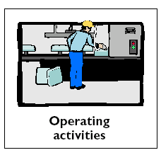
Types of Cash Flows -
Operating Activities
Cash inflows:
  From sale of goods or services
  From return on loans (interest received) and on equity securities (dividends received)
Cash outflows:
  To suppliers for inventory
  To employees for services
  To government for taxes
  To lenders for interest
  To others for expenses

Slide 6

Types of Cash Flows -
Investing Activities
Cash inflows:
  From sale of property, plant, and equipment
  From sale of debt or equity securities of other entities
  From collection of principal on loans to other entities
Cash outflows:
  To purchase property, plant, and equipment
  To purchase debt or equity securities of other entities
  To make loans to other entities

Slide 7

Types of Cash Flows -
Financing Activities
Cash inflows:
  From sale of equity securities (company's own stock)
  From issuance of debt (bonds and notes)
Cash outflows:
  To stockholders as dividends
  To redeem long-term debt or reacquire capital stock

Slide 8
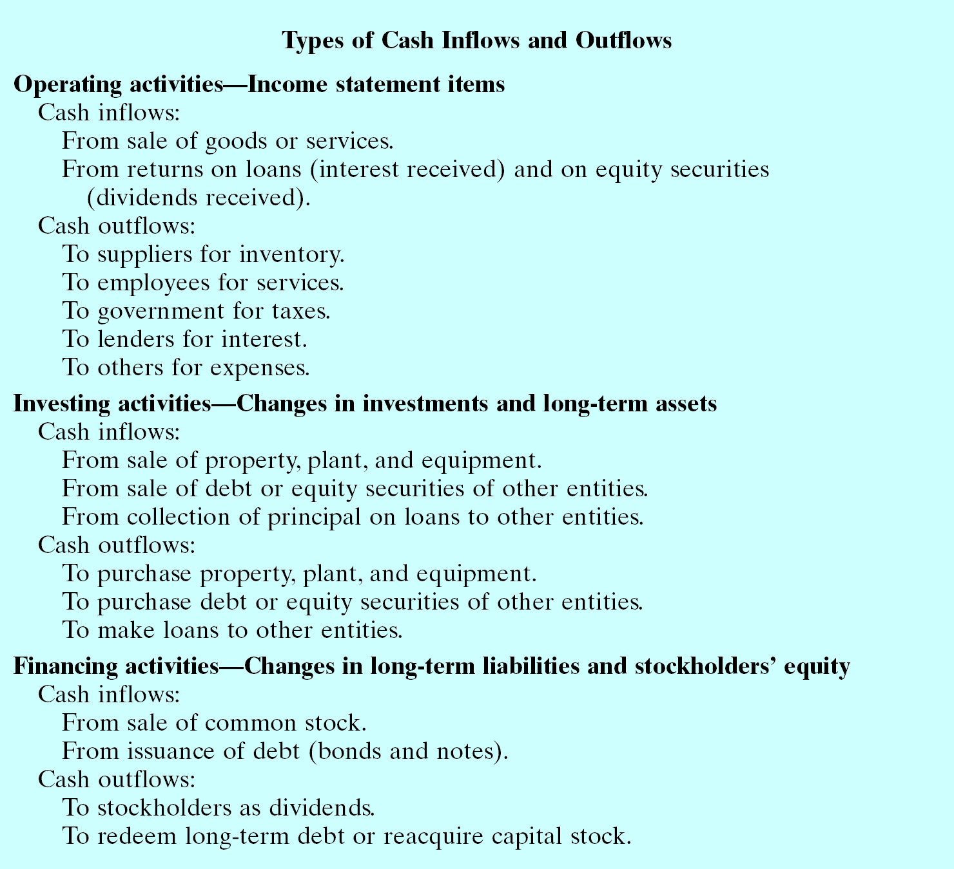

Slide 9
Significant
Noncash Activities...
That do NOT affect cash are NOT reported in the body of the statement of cash flows.
Are reported:
  In a separate schedule at the bottom of the statement of cash flows or
  In a separate note or supplementary schedule to the financial statements.

Slide 10
Significant
Noncash Activities...
  1. Issuance of common stock to purchase assets.
  2. Conversion of bonds into common stock.
  3. Issuance of debt to purchase assets.
  4. Exchanges of plant assets.

Slide 11
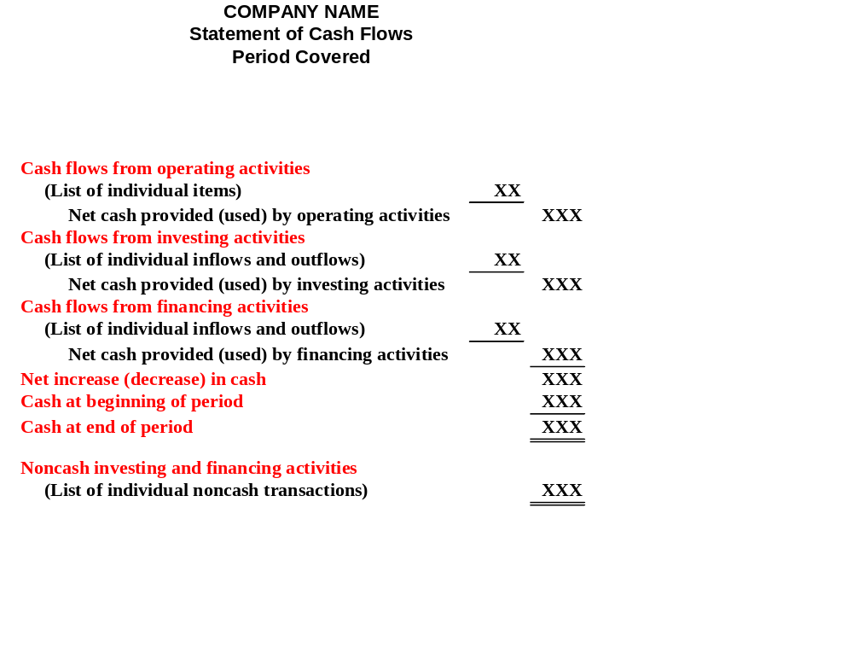
FORMAT OF STATEMENT OF CASH FLOWS
The general format of the SCF:
Is the 3 activities previously discussed – operating, investing, and financing – plus the significant noncash investing and financing activities.

Slide 12
USEFULNESS OF THE STATEMENT OF CASH FLOWS
1) Ability to generate future cash flows.
2) Ability to pay dividends and meet obligations.
3) Reasons for the difference between net income and net cash provided (used) by operating activities.
4) Cash invested and financing transactions during the period.
Notes:
9

Slide 13
PREPARING THE STATEMENT OF CASH FLOWS
Information to prepare this statement
usually comes from 3 sources:
1) Comparative balance sheet.
2) Current income statement.
3) Additional information.
The SCF deals with cash receipts and
payments, so the accrual concept is
not used in the preparation of the SCF.
Notes:
17

Slide 14
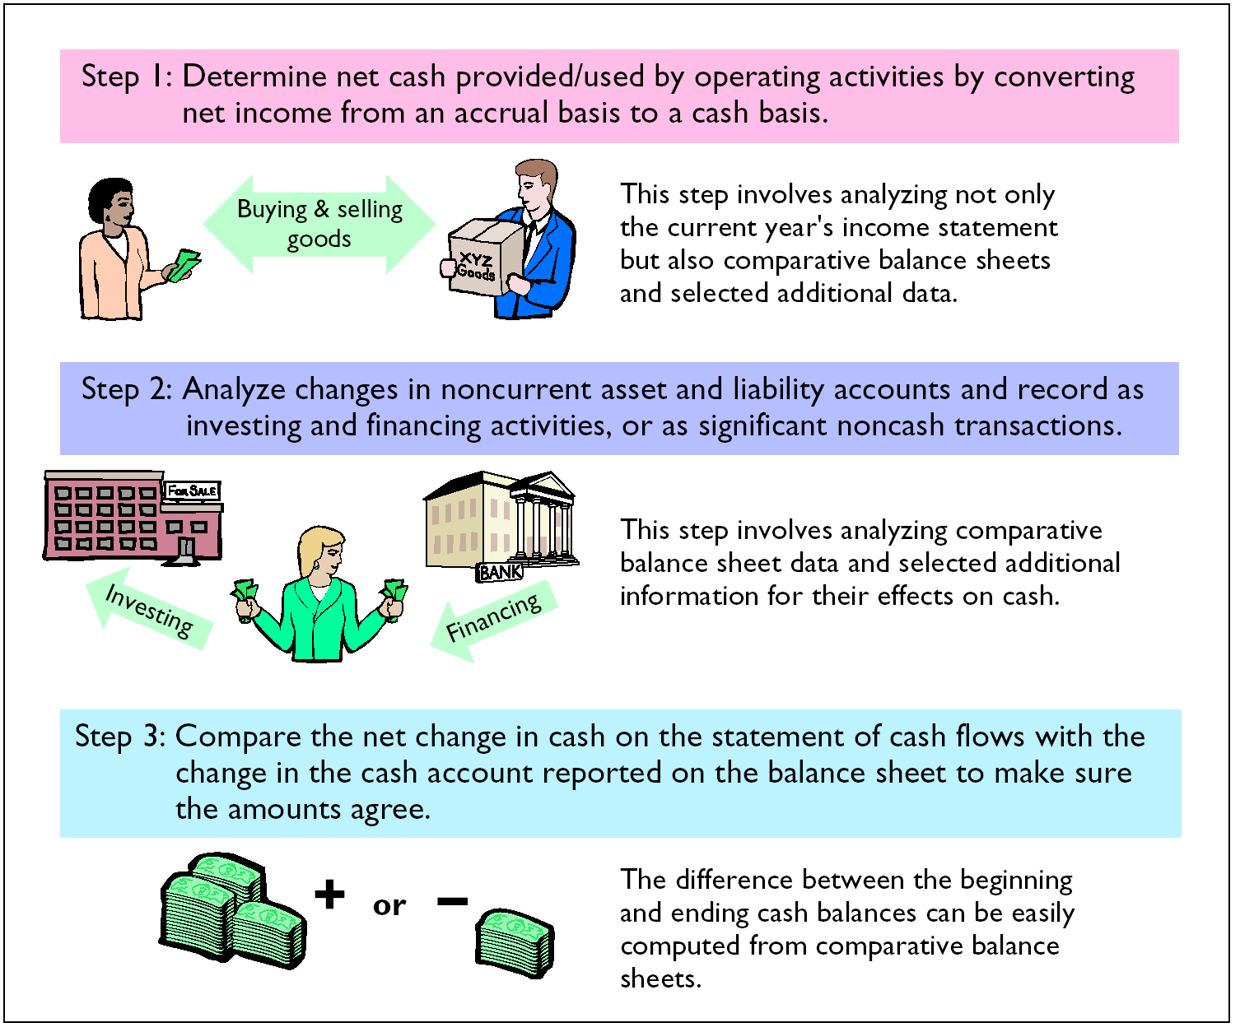
THREE MAJOR STEPS IN PREPARING THE STATEMENT OF CASH FLOWS

Slide 15
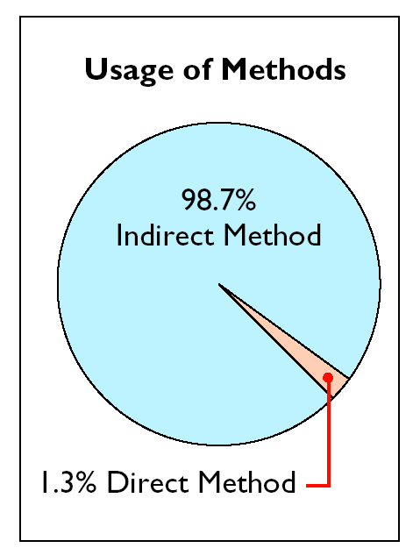
USAGE OF INDIRECT AND DIRECT METHODS
In order to determine net cash provided/used by operating activities, the operating activities section must be converted from accrual basis to cash basis. This conversion may be accomplished by :
the indirect method or
the direct method.
The indirect method is used extensively in practice, as shown below.
The indirect is favored by companies for 2 reasons:
- it is easier to prepare and
- it focuses on the differences between net income and net cash flow from operating activities.
Notes:
27

Slide 16
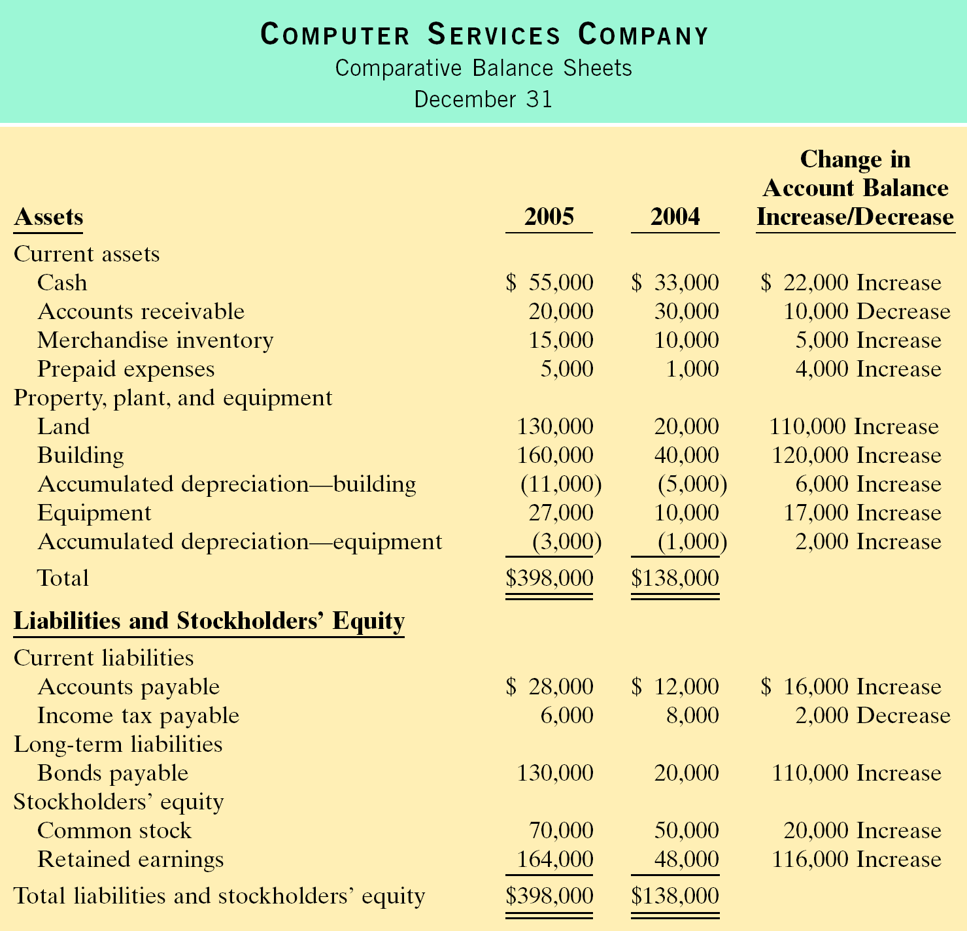
COMPARATIVE BALANCE SHEET, 2005, WITH INCREASES AND DECREASES
Study Objective 3
The comparative balance sheets at the beginning and end of 2005 – showing increases and decreases – are shown to the right.
Notes:
14

Slide 17
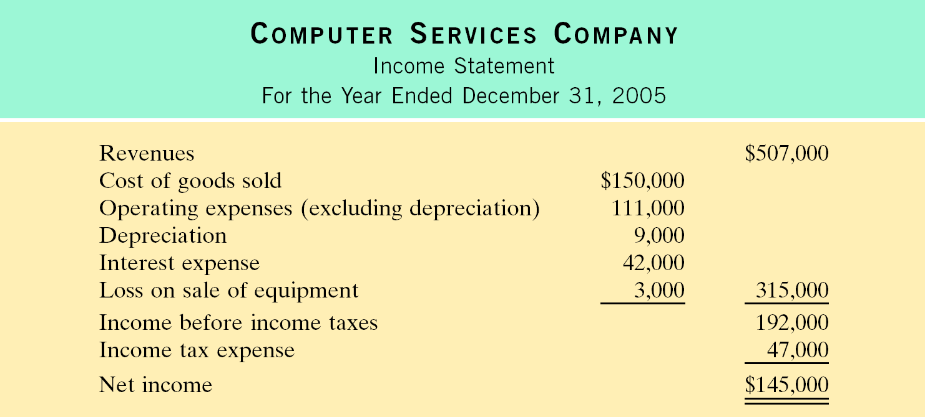
INCOME STATEMENT AND ADDITIONAL INFORMATION, 2005
The income statement and additional information for 2005 for Computer Services Company are shown to the right.

Slide 18

ANALYSIS OF ACCUMULATED DEPRECIATION — EQUIPMENT
The increase in Accumulated Depreciation – Equipment was $2,000, which does not represent depreciation expense for the year since the account was debited $1,000 as a result a sale of some equipment.
Depreciation expense for 2005 was $3,000.
This amount is added to net income to determine net cash provided by operating activities.
The T-account below provides information about the changes that occurred in this account in 2005.
Notes:
15

Slide 19
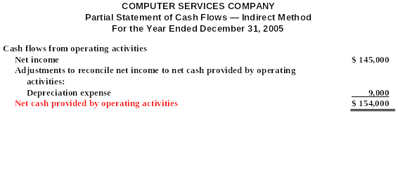
PRESENTATION OF NET CASH PROVIDED BY OPERATING ACTIVITIES, 2005 — INDIRECT METHOD
Net cash provided by operating activities for 2005 is $154,000 as calculated below.

Slide 20

ANALYSIS OF EQUIPMENT
Equipment increased $17,000, which was a net increase that resulted from 2 transactions:
1) a purchase of equipment of $25,000 and
2) the sale of equipment costing $8,000 for $4,000.
These transactions are classified as investing activities and each should be reported separately. The purchase of equipment should therefore be reported as an outflow of cash for $25,000 and the sale should be reported as an inflow of cash for $4,000. The T-account below shows the reasons for the change in this account during the year.

Slide 21
STATEMENT OF CASH FLOWS, 2005-INDIRECT METHOD
COMPUTER SERVICES COMPANY
Statement of Cash Flows
For the Year Ended December 31, 2005
Cash flows from operating activities Net income Adjustments to reconcile net income to net cash provided by operating activities: Depreciation expense Loss on sale of equipment Decrease in accounts receivable Increase in merchandise inventory Increase in prepaid expenses Increase in accounts payable Decrease in income tax payable Net cash provided by operating activities | $ 9,000 3,000 10,000 (5,000) (4,000) 16,000 (2,000) | $145,000 27,000 $172,000

Slide 22
STATEMENT OF CASH FLOWS, 2005-INDIRECT METHOD
COMPUTER SERVICES COMPANY
Statement of Cash Flows
For the Year Ended December 31, 2005
Cash flows from investing activities Purchase of building Purchase of equipment Sale of equipment Net cash used by investment activities Cash flows from financing activities Issuance of common stock Payment of cash dividends Net cash used by financing activities Net increase in cash Cash at beginning of period Cash at end of period Noncash investing and financial activities Issuance of bonds payable to purchase land | $(120,000) ( 25,000) 4,000 20,000 (29,000) | $(141,000) (9,000) 22,000 33,000 $ 55,000 $ 110,000

Slide 23

SECTION 2 STATEMENT OF CASH FLOWS DIRECT METHOD
Study Objective 4
The transactions of Juarez Company for 2005 and 2004 are used to illustrate and explain the indirect method of preparing the SCF.
1 Juarez Company started on January 1, 2003, when it issued 300,000 shares of $1 par value common stock for $300,000 cash.
2 The company rented its office, sales space, and
equipment.

Slide 24
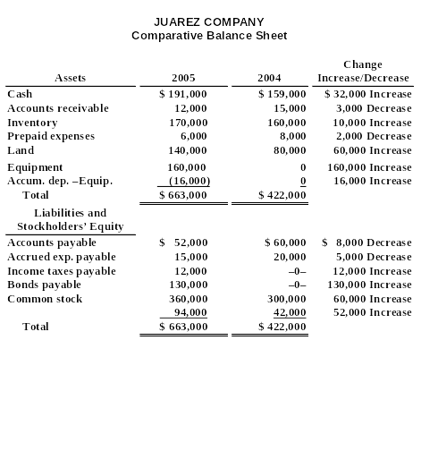
COMPARATIVE BALANCE SHEETS WITH INCREASES AND DECREASES
The comparative balance sheets at the end of 2005 and end of 2004 showing increases and decreases – are shown to the right.

Slide 25
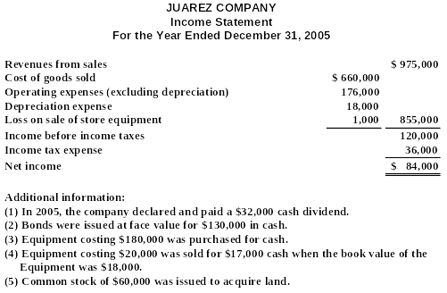
INCOME STATEMENT AND ADDITIONAL INFORMATION, 2005
The income statement and additional information for 2005 for Juarez Company are shown.

Slide 26
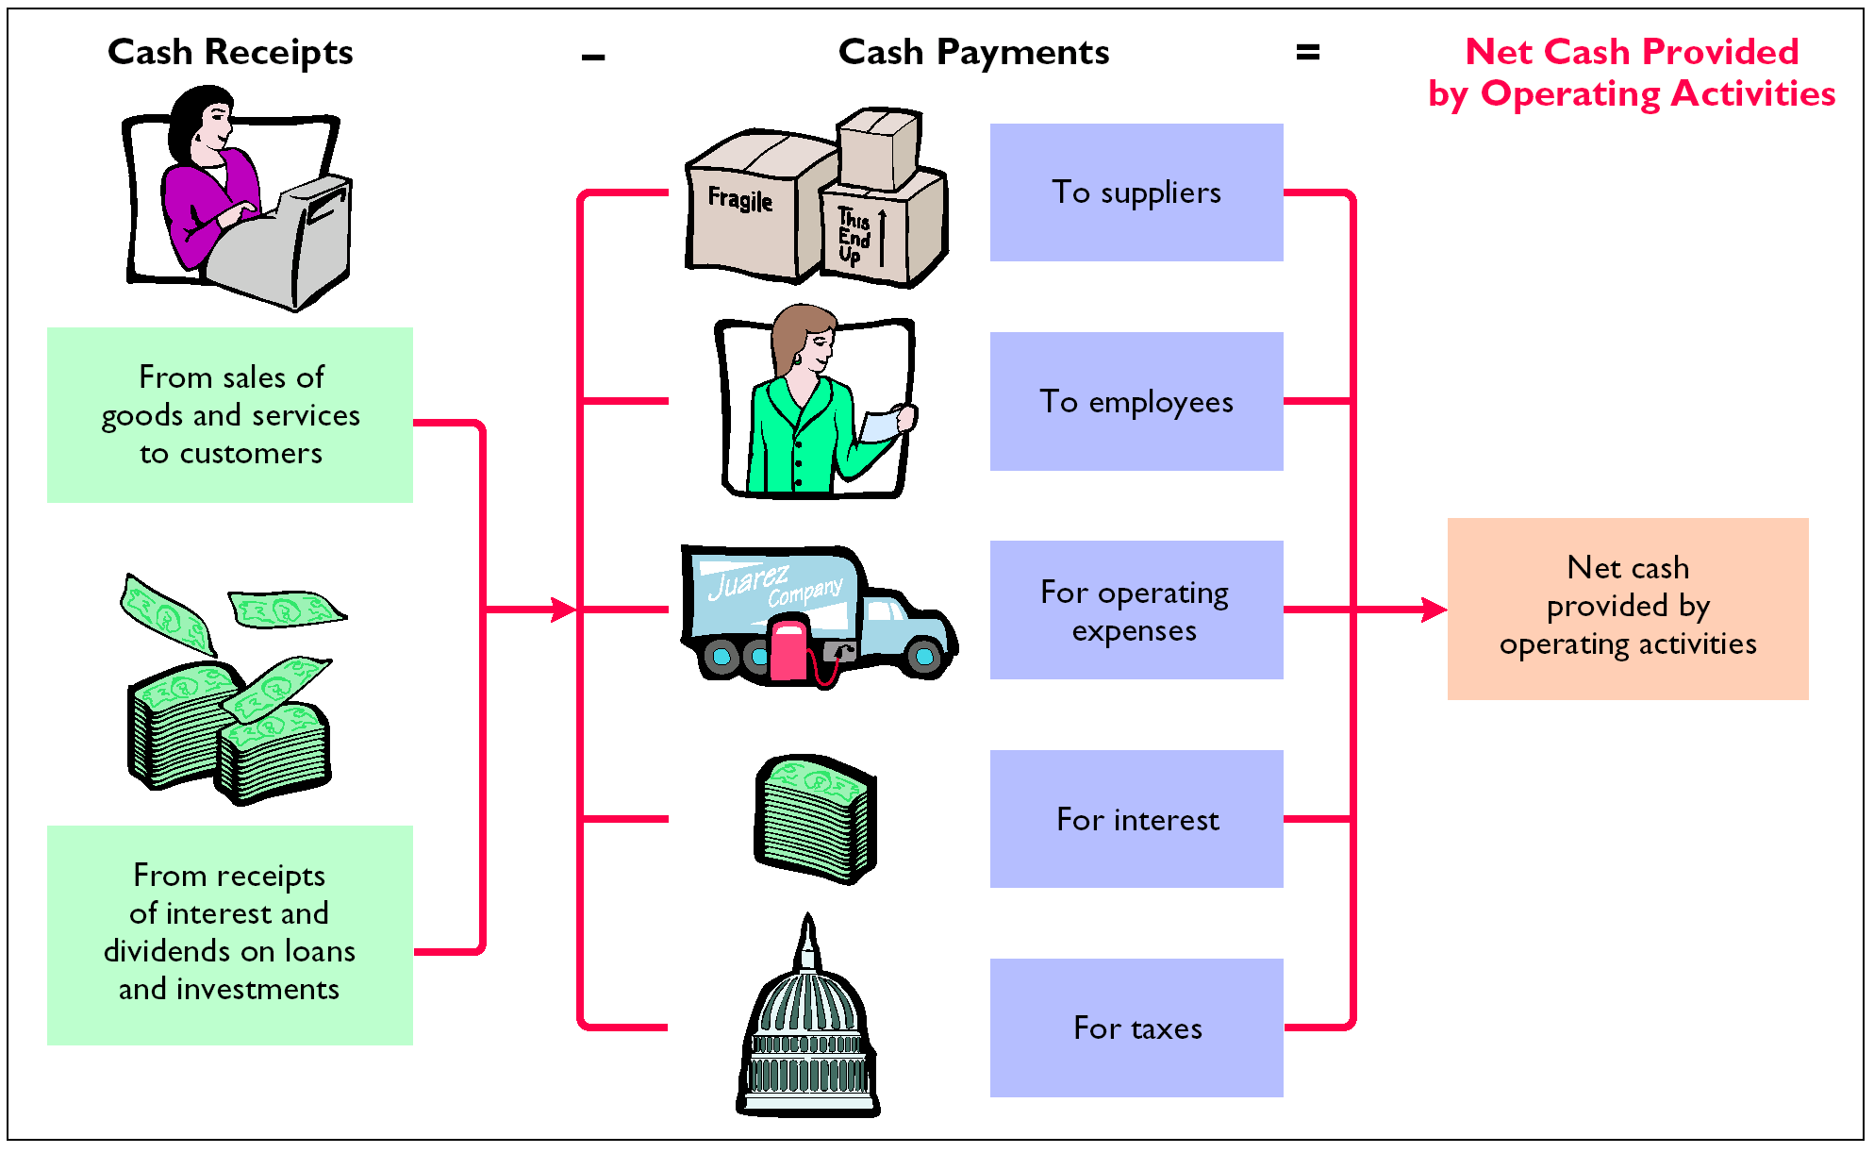
MAJOR CLASSES OF CASH RECEIPTS AND PAYMENTS

Slide 27
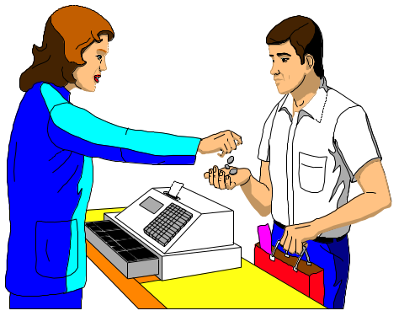
CASH RECEIPTS FROM CUSTOMERS
The income statement for Juarez Company reported revenues from customers of $975,000.
To determine the amount of cash receipts, the decrease in accounts receivable is added to sales
revenue.
Conversely, an increase in accounts receivable is deducted from sales revenues.

Slide 28
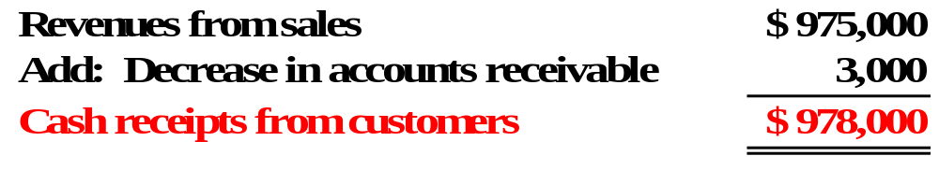
COMPUTATION OF CASH RECEIPTS FROM CUSTOMERS
Revenues from sales were $975,000. Cash receipts from customers were greater than sales revenues since accounts receivable decreased $3,000. Cash receipts from customers were $978,000, as calculated below.

Slide 29


FORMULA TO COMPUTE CASH RECEIPTS FROM CUSTOMERS — DIRECT METHOD
The relationships among cash receipts from customers, revenues from sales, and changes in accounts receivable.
{
Cash receipts from customers
=
Revenues from sales
+ Decrease in accounts receivable or – Increase in accounts receivable

Slide 30

COMPUTATION OF PURCHASES
Juarez Company reported cost of goods sold on its income statement of $660,000. To determine purchases, cost of goods sold must be adjusted for the change in inventory. An increase (decrease) in inventory is added to (deducted from) cost of goods sold to arrive at purchases. In 2005, Juarez Company’s inventory increased $10,000. Purchases are calculated as follows.

Slide 31

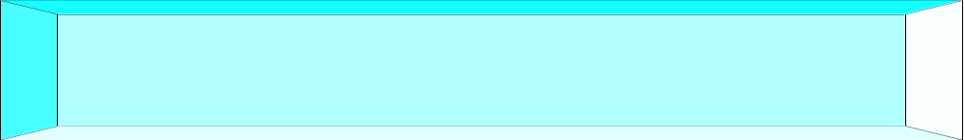
FORMULA TO COMPUTE CASH PAYMENTS TO SUPPLIERS — DIRECT METHOD
The relationship among cash payments to suppliers, cost of goods sold, changes in inventory, and changes in accounts payable is shown.
Cash payments to suppliers
=
+ Increase in inventory or – Decrease in inventory
+ Decrease in accounts payable or – Increase in accounts payable
Cost of goods sold

Slide 32
COMPUTATION OF PURCHASES
Juarez Company reported cost of goods sold on its income statement of $660,000. To determine cash paid for purchases, cost of goods sold must be adjusted for the change in inventory and the change in accounts payable. An increase (decrease) in inventory is added to (deducted from) cost of goods sold and an increase (decrease) in accounts payable is deducted from (added to) cost of goods sold to arrive at cash payments for purchases. In 2005, Juarez Company’s inventory increased $10,000. Accounts payable decreased $8,000. Cash payments for purchases are calculated as follows.
Cost of goods sold $660,000
Add: Increase in inventory 10,000
Add: Decrease in accounts payable 8,000
Cash paid for purchases $678,000

Slide 33
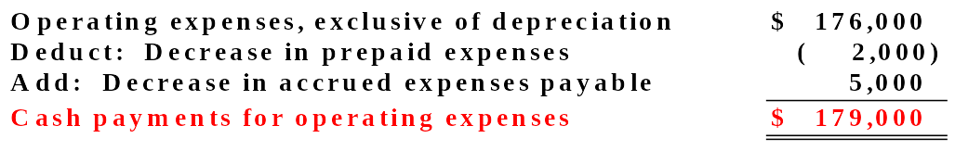
COMPUTATION OF CASH PAYMENTS FOR OPERATING EXPENSES
Operating expenses (exclusive of depreciation expense) was $176,000 for 2005. The $2,000 decrease in prepaid expenses is deducted and the $5,000 decrease in accrued expenses payable is added in determining cash payments for operating expenses, as shown in Illustration 18-23.

Slide 34


FORMULA TO COMPUTE CASH PAYMENTS FOR INCOME TAXES — DIRECT METHOD
The relationships among cash payments for income taxes, income tax expense, and changes in income taxes payable are as follows.
Cash payments for income taxes
=
Income tax expense
+ Decrease in income taxes payable or – Increase in income taxes payable

Slide 35
COMPUTATION OF CASH PAYMENTS FOR INCOME TAXES
Juarez Company reported income tax expense of $36,000. Income taxes payable increased $12,000. Cash payments for income taxes are calculated as follows.
Income tax expense $36,000
Less: Increase in income taxes payable 12,000
Cash paid for income tax expense $24,000

Slide 36
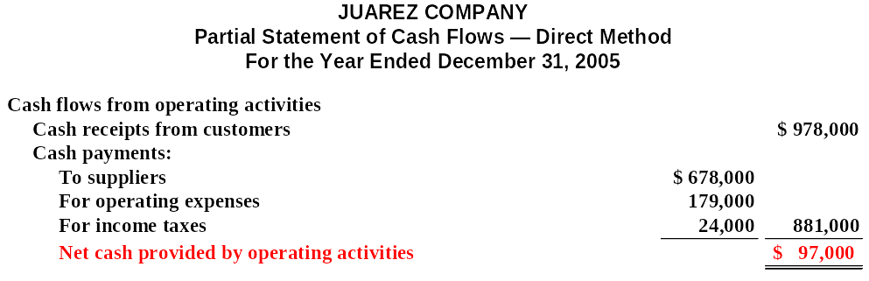
OPERATING ACTIVITIES SECTION — DIRECT METHOD
All of the revenues and expenses in the 2005 income statement have now been adjusted to cash basis.
The operating activities section of the SCF is shown below.

Slide 37
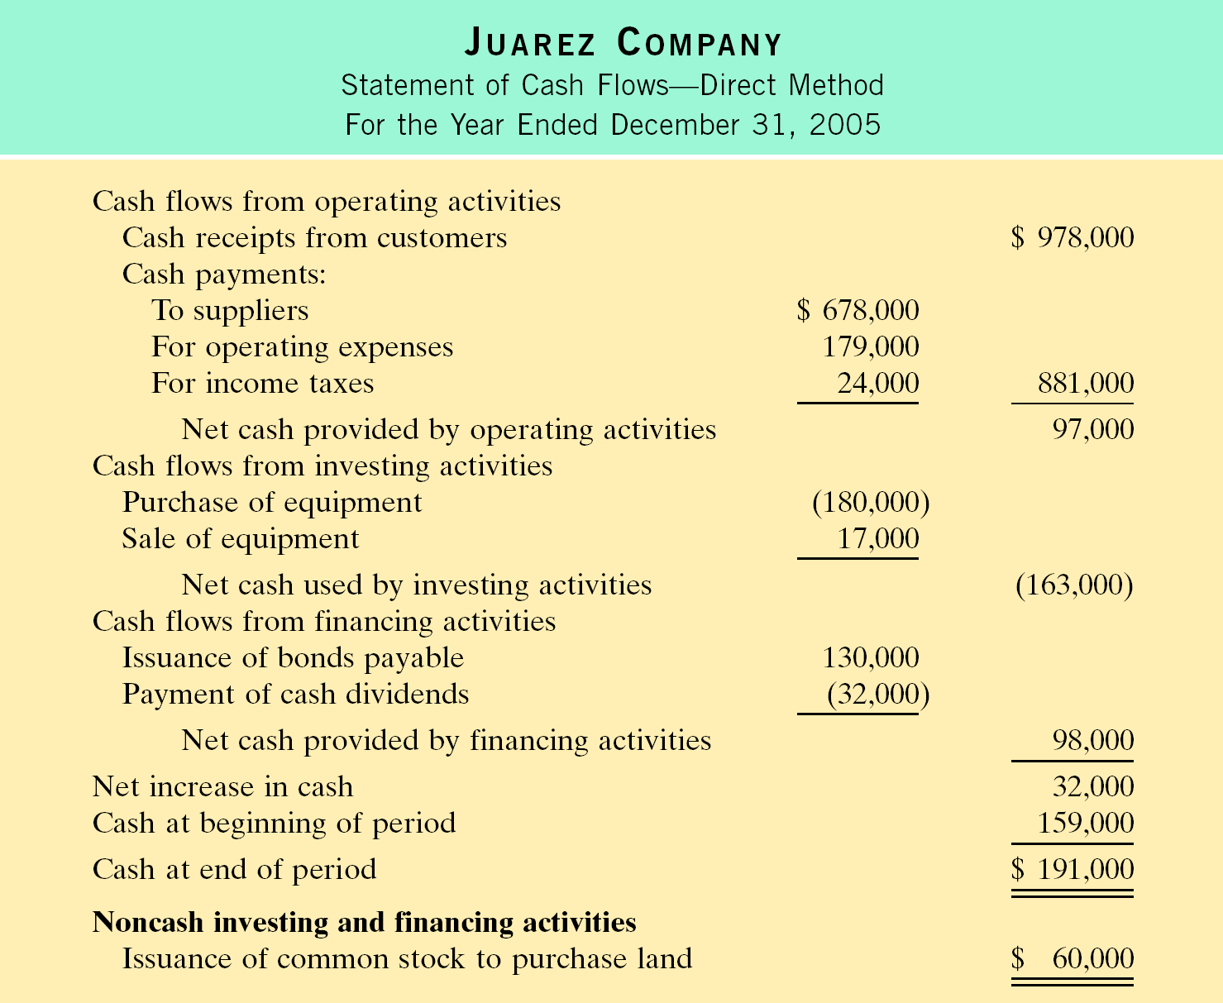
STATEMENT OF CASH FLOWS 2005 — DIRECT METHOD

Slide 38

FREE CASH FLOW
Study Objective 5
Free Cash Flow – Cash provided by operating activities adjusted for capital expenditures and dividends paid.

Slide 39
Review
Which of the following items is reported on a cash flow statement prepared by the direct method?
Loss on sale of building.
Increase in accounts receivable.
Depreciation expense.
Cash payments to suppliers.

Slide 40
Review
Which of the following items is reported on a cash flow statement prepared by the direct method?
Loss on sale of building.
Increase in accounts receivable.
Depreciation expense.
Cash payments to suppliers.

Slide 41

COPYRIGHT
Copyright © 2005 John Wiley & Sons, Inc. All rights reserved. Reproduction or translation of this work beyond that permitted in Section 117 of the 1976 United States Copyright Act without the express written consent of the copyright owner is unlawful. Request for further information should be addressed to the Permissions Department, John Wiley & Sons, Inc. The purchaser may make back-up copies for his/her own use only and not for distribution or resale. The Publisher assumes no responsibility for errors, omissions, or damages, caused by the use of these programs or from the use of the information contained herein.

